Slide 1
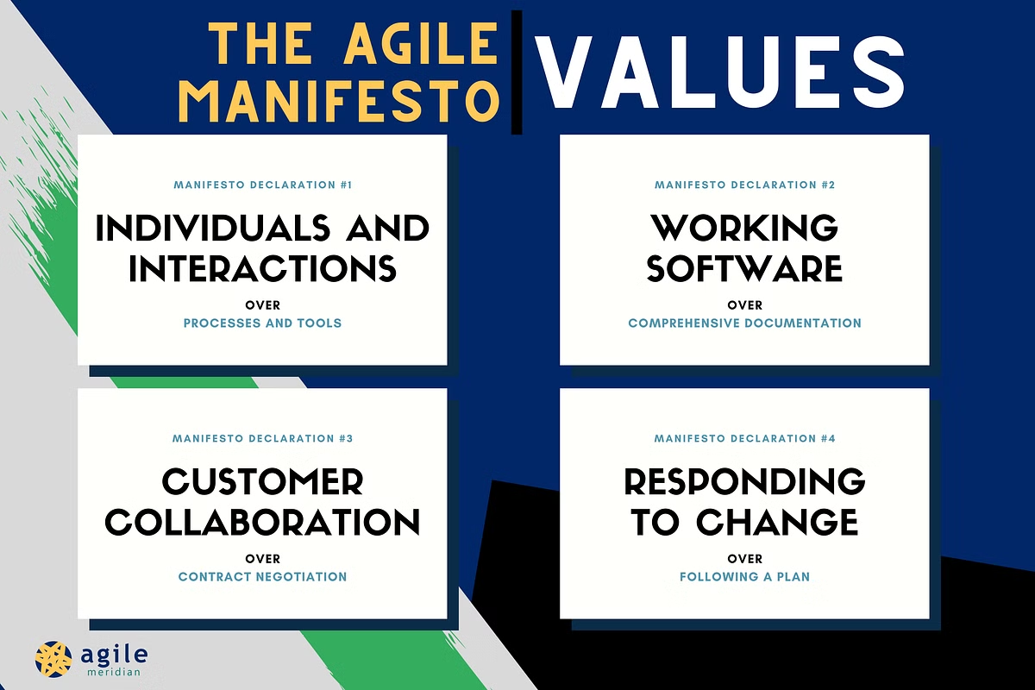
AGILE VALUES
The Agile methodology is a project management framework for software development that emphasizes collaboration and continuous improvement
Agile is based on four values: individuals and interactions over processes and tools, working software over documentation, customer collaboration over contract negotiation, and responding to change over following a plan
These values are crucial for organizations that want to adapt quickly to changing needs and deliver value to customers.

Slide 2
AGILE PRINCIPLES
Customer satisfaction through early and continuous delivery of valuable software.
Welcome changing requirements, even late in development. Agile processes harness change for the customer's competitive advantage.
Deliver working software frequently, with a preference for shorter timescales (weeks rather than months).
Collaboration between business stakeholders and developers throughout the project.
Motivate and support individuals by providing the environment and trust they need to get the job done.
Face-to-face communication is the most efficient and effective method of conveying information within a development team.
Working software is the primary measure of progress.
Sustainable development, where developers, stakeholders, and users should be able to maintain a constant pace indefinitely.
Technical excellence and good design enhance agility.
Simplicity—the art of maximizing the amount of work not done—is essential.
Self-organizing teams produce the best designs, architectures, and requirements.
Regular reflection on how to become more effective, with the team adjusting its behavior accordingly.
These principles support a flexible and adaptive approach to software development that encourages collaboration, quick feedback, and continuous improvement.

